Slide 1
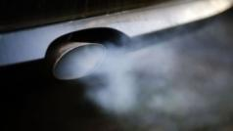
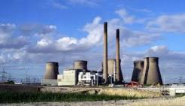
The Martin Williams Lecture 2024
The Future of Air Quality: Opportunities and Challenges.
Prof. Alastair Lewis

Slide 2
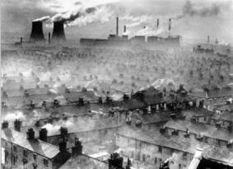
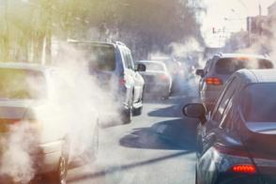
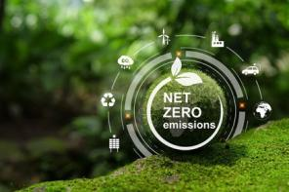
Adaption and transformation

Slide 3
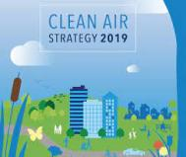
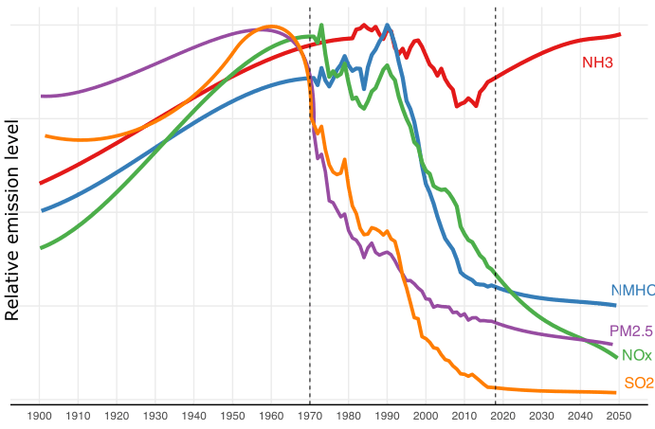
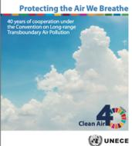
50 years of reducing UK emissions
Simplistically ambient pollution = emissions x weather x chemistry
Only the emissions are under policy/regulatory control
Most easy wins have been taken already
National levers
International levers
Taken from Royal Society report on “Effects of climate change and net zero policies on air quality” Chapter 4, D. Carslaw et al.
Notes:
Follow up, might touch on why some pollutant trends are much better than others. Ammonia is an agricultural problem, but it interacts with NOx to form PM2.5.

Slide 4
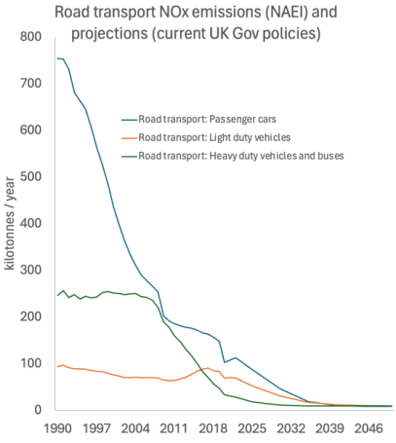
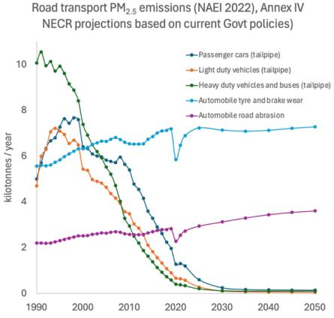
Rate of change in transport sector
Historically a major contributor to urban air pollution
Changing rapidly, and now much lower tailpipe emissions
Friction-related emissions remain with BEVs / Fuel cells
Road transport changes
Tailpipe NO_{x} the focus of recent national and city interventions
Not yet at zero tailpipe emissions, but there is only limited future scope.
Non-exhaust PM emissions remain into the future
Some increases possible given extra miles driven

Slide 5
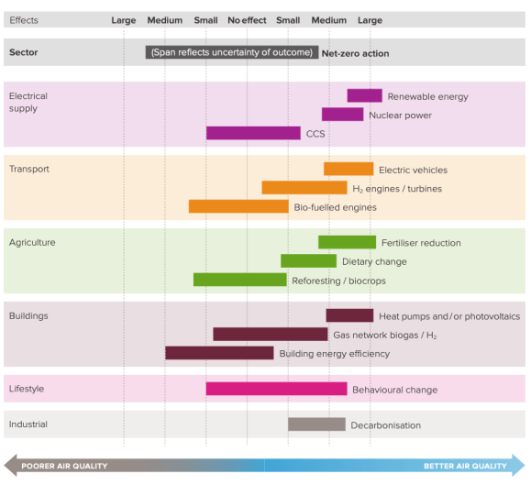
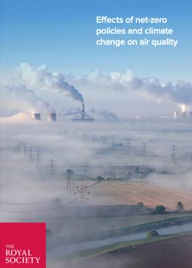
The wider decarbonisation opportunities
Key messages
1) Try not to burn stuff to get to net zero.
2) If you must, do (much) better for AQ than the incumbent fuel/technology

Slide 6
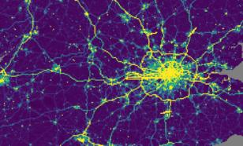
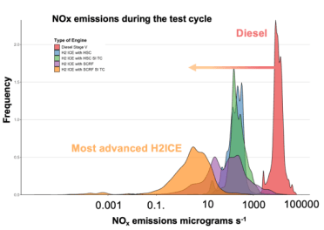
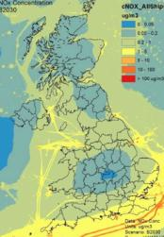
Promoting clean net zero combustion
Battery electrification seem unlikely to support a net zero transition for:
1) international maritime
2) construction and heavy off-road (NRMM)
3) medium and long-haul aviation
Aircraft LTO now visible as a major ground level source of NO_{x} relative to other emissions. (NAEI 2022)
NRMM sector recommending hydrogen internal combustion engines for net zero, rather than fuel cells or batteries. Awareness that air quality performance must be much better than diesel. (Webster et al. 2024 / JCB)
Estimated contribution of shipping to [NO_{x}] in 2030. (From Defra / Ap Simon et al. 2021.)

Slide 7
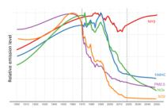
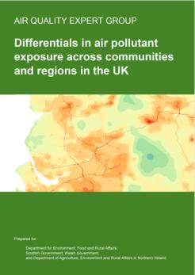
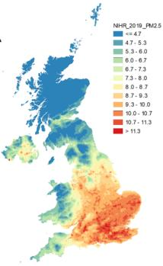
Taking a more targeted approach
Reducing sectoral emissions top-down has worked well historically
Principle of ‘a rising tide lifts all boats’ for air quality
Does little to address structural disparities in where people and emissions are located.
The Defra Air Quality Expert group have recently completed a report considering this issue and implications for future policy
Where you live in the UK has a profound influence over the air quality you experience
Some disparity is driven by meteorology and closeness to transboundary sources.
Some is driven by where communities live and where as a society we chose to locate our emissions.

Slide 8
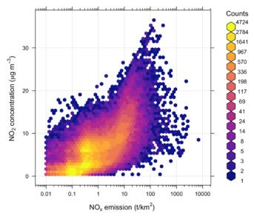
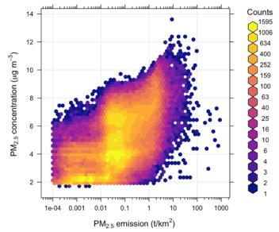
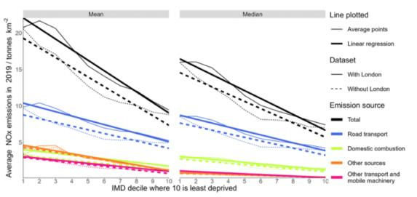
Taking a more targeted approach
There is a relatively loose overall association between the concentration of NO₂ and PM_{2.5} in air and the total emissions in your (1 km x 1km) neighbourhood.
At the LSOA level, more derived communities experience, on average, higher local emissions of NO_{x} and PM_{2.5} than less deprived communities.
Road transport, heating, industry, NRMM all contribute to the disparity

Slide 9
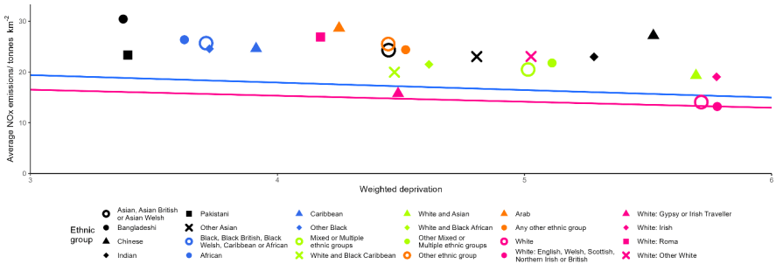
Taking a more targeted approach
Minority ethnicity communities experience higher emissions than white British communities in their neighbourhoods, even after the effects of deprivation have been accounted for.
Past policy approaches of sectoral technical emissions reductions may in the future have only limited impact in reducing air quality disparities that exist across the UK.

Slide 10
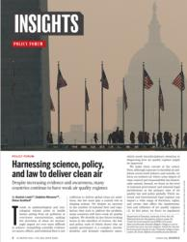
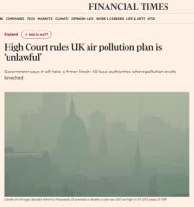
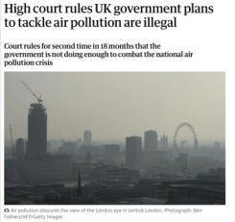
The future of air quality standards
With thanks for Eloise Scotford and Delphine Misonne
Science evidence that identifies the need for improving air quality is vitally important, but it is the existence of laws that compels Governments act.
Complying with legal requirements will always come first, so the scientific framing of those legal standards will shape policy responses.
So what might our future legal standards look like?

Slide 11
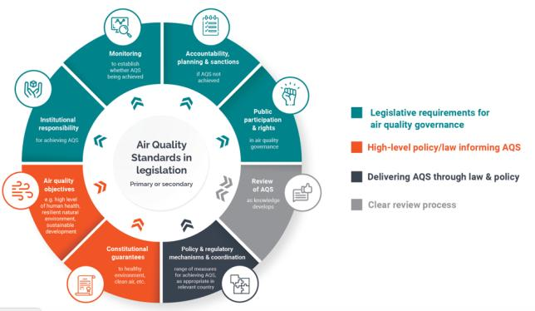
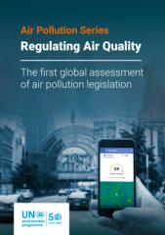
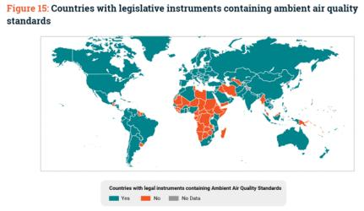
Air quality governance
There is more to effective air quality standards than just picking a limit value
WHO air quality guidelines can dominate discussions, around ‘Objectives‘
Less emphasis on the other 7 sectors

Slide 12
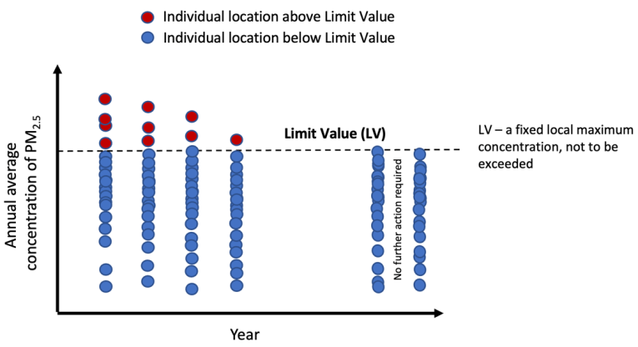
Objectives as limit values
In locations with poor air quality, very powerful and simple legal tool for driving change
As air quality improves fewer locations exceed limits
Interventions focus around non-compliant locations, not always population benefit

Slide 13
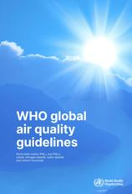
WHO and future limit values
Limit values often discussed in context of WHO recommendations, but is this always reasonable?
If there is no lower limit to harm from pollution?
A zero pollution world isn’t possible, so limits values and WHO (now and future) may have to diverge.
Is a health-based guideline reasonable as a limit value?
Are they scientifically feasible?
Yes
Are they socially/politically /economically feasible?
How to ensure ambition?
No
Limit value different to WHO accounting for local realities
Yes
No
Options
Arguments all in favour
Clarity about reasons why not
Subtract ’non controllable pollution’ such as wildfires, transboundary
A perpetual breach of the law
Air quality is ignored, since you can’t ever win
Grant executive discretion

Slide 14
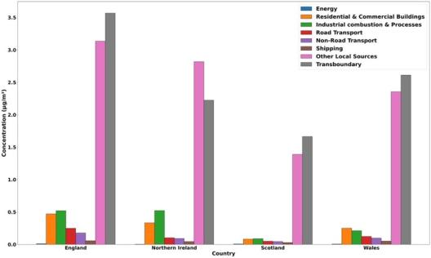
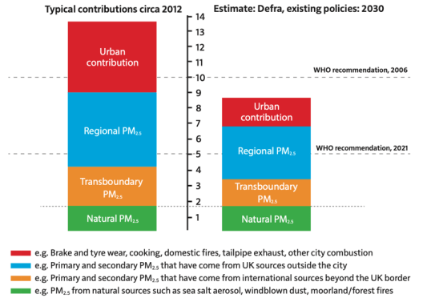
UK-specific challenges
UK has natural emissions of PM and precursors e.g. seasalt, biomass, biogenic, dust.
Large transboundary contribution to PM_{2.5} particularly in SE England.
5 μg m⁻³ almost fully accounted for before UK anthropogenic emissions occur.

Slide 15
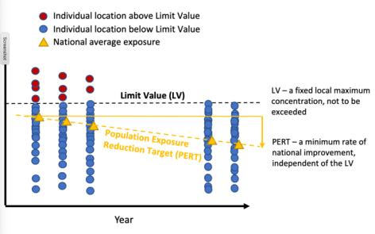
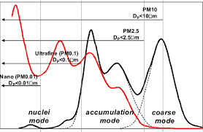
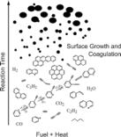
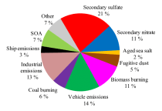
Alternative objectives
Targets already in place for population exposure reduction - improvement in complaint locations.
Other measures possible around targets for reduction in inequality and disparity, where that is under policy influence
Examples in US around environment justice in decision-making.
More specificity of PM targets?
Reducing PM_{2.5} mass is now hard in the UK, but some harmful subcomponents / metrics may be more directly targeted?
PM₁, PM_{0.1}, Ultra Fine Particles UFP, Black Carbon, particle number size distribution, particle number, POA, SOA, metals, PAHs, microplastics...?

Slide 16
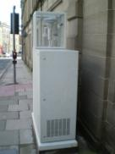
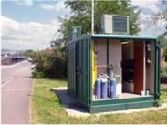
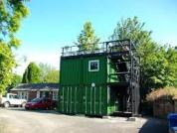
What to regulate and control? A chicken and egg problem
Without epidemiological evidence its hard to set evidence-based ambient air quality objectives.
Without observations its hard to do epidemiology and assemble the health evidence.
Without a legal requirement, it is difficult to support long-term observations needed for epidemiology.
Measurement method created
Monitoring data collected
Epidemiological studies
New monitoring
commissioned
Health / economic
impact assessments
Emissions reductions introduced
Legal AQ standards
developed
A legal obligation for precautionary monitoring?

Slide 17
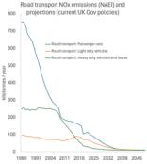
Summary
Considerable progress in reducing emissions over the long-term, now in a period of diminishing returns when using top-down sectoral emissions policy levers.
The future will be much more than batteries; we need to argue the case for net zero combustion to also be very clean.
Addressing disparities in where remaining emissions occur and how different communities are exposed needs greater focus
Legal standards set the agenda for government action, not our papers; an area where the scientific community needs to further engage.
Open debate needed around aligning WHO health guidelines and future standards in some countries. No easy answers.
Precautionary monitoring of non-regulated pollutants may be needed to break regulatory incumbency cycles.

