Slide 1
Social Justice and Health
Professor Michael Marmot
@MichaelMarmot
http://www.instituteofhealthequity.org/

Slide 2
Why treat people and send them back to the conditions that made them sick?

Slide 3
Marmot Principles
Create and develop healthy and sustainable places and communities
Strengthen the role and impact of ill health prevention
Tackle racism, discrimination and their outcomes
Pursue environmental sustainability and health equity together
Give every child the best start in life
Enable all children, young people and adults to maximise their capabilities and have control over their lives
Create fair employment and good work for all
Ensure healthy standard of living for all

Slide 4
Excess deaths in each decile of area deprivations, based on the Index of Multiple Deprivation, by sex, England, 2011-2019
Source: ONS population estimates and death rates for deprivation deciles in England
Note: See statistical appendix Health Inequalities, Lives Cut Short (2024) for method of calculation of excess deaths

Slide 5
Excess deaths in each year 2009 to 2020, based on area deprivation deciles using the Index of Multiple Deprivation
Source: ONS population estimates and death rates for deprivation deciles in England
Note: See statistical appendix Health Inequalities, Lives Cut Short (2024) for method of calculation of excess deaths

Slide 6
Proportionate Universalism

Slide 7
Levelling–up the social gradient in health

Slide 8
Change in government funding per head of population by 2019/20 by male life expectancy in 2010-12, local authorities in England
Source: NAO (2023 and ONS (2024)

Slide 9
Challenges

Slide 10
Child poverty rates 2019-2021
Source: UNICEF Innocenti

Slide 11
Change in child income poverty rates, 2012-2014 to 2019-2021
Source: UNICEF Innocenti
Notes:
Source: UNICEF Innocenti; see the Technical Annex of Report Card 18: Child Poverty in the Midst of Wealth for details. Note: The data for 2014 included figures from 2012–2014 and data from 2021 included figures from 2019–2021.

Slide 12
The number of people experiencing destitution in the UK increased by 148% from 2017 to 2022
3.8

Slide 13
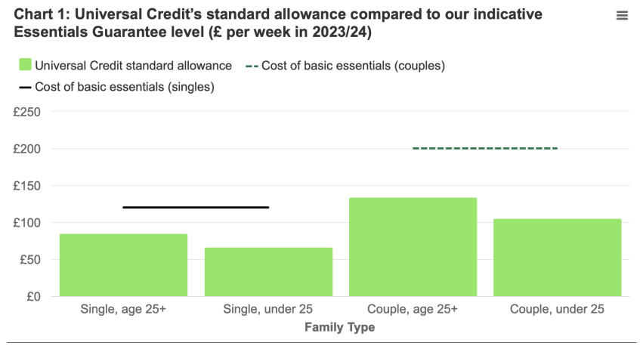
JRF and Trussell Trust “Guarantee Our Essentials” 2023

Slide 14
Percent of working-age adults in poverty in working families (where at least one adult is in work), 3 year average, 2017/18-2019/20
Source: HBAI

Slide 15
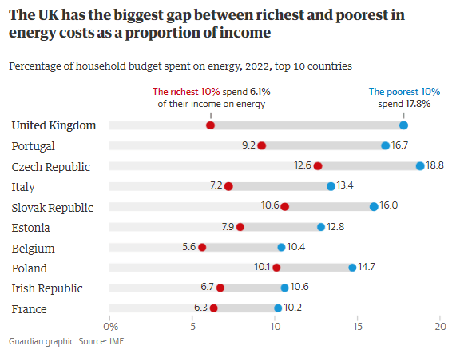

Slide 16
Pursue Environmental Sustainability together
to create
A Fairer, Healthier and more Sustainable society

Slide 17
Advisory Group Report for the UK Committee on Climate Change

Slide 18
Areas for action on health equity and GHGs
Transport
Buildings
Diet
Work and employment patterns
Running through all of this is air pollution
Health Equity as an explicit goal

Slide 19
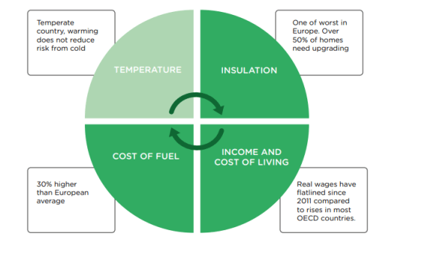
An imperfect storm - causes of cold homes

Slide 20
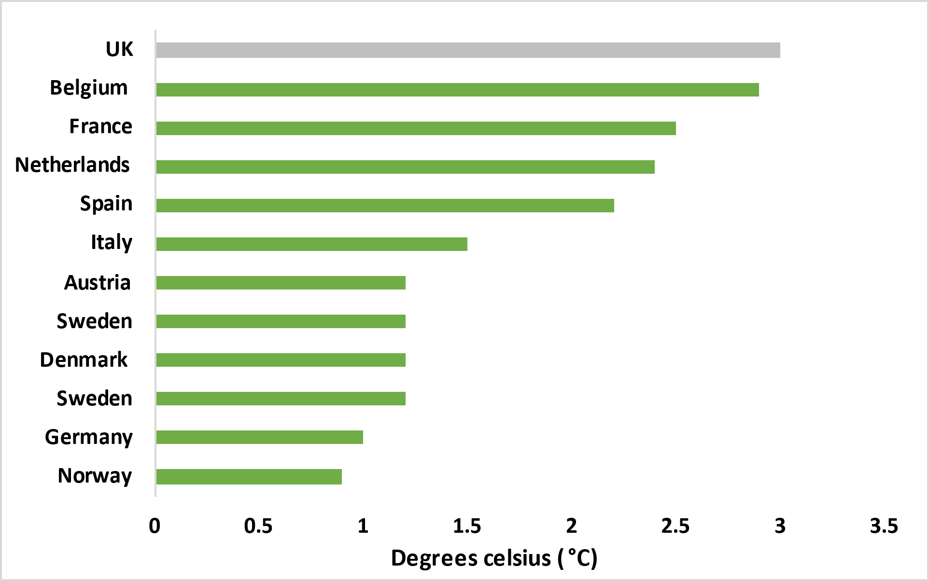
POOR LEVELS OF INSULATION Home temperature loss after 5 hours compared to European neighbours
Over 50% of our homes are energy inefficient (less than EPC C)
Home heat loss*, degrees Celsius, UK and European neighbours, 2020
https://www.tado.com/gb-en/press/uk-homes-losing-heat-up-to-three-times-faster-than-european-neighbours
*Home temperature loss after 5 hours, with a temperature of 0°C outside and 20°C inside.

Slide 21
Children from low-income households more likely to live in are with high air pollution

Slide 22
Living in areas with unfavourable environmental conditions​ in England

Slide 23
Action

Slide 24
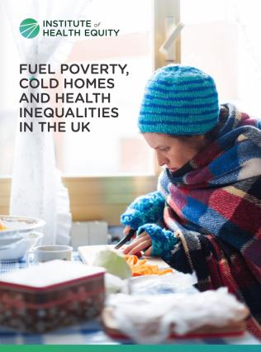
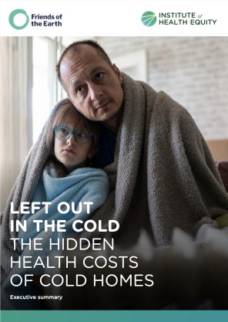

Slide 25
Marmot Places – 40+ local authorities
Coventry
Greater Manchester
Cheshire and Merseyside
Lancashire and Cumbria
Luton
Waltham Forest
Gwent
Southwest region
Leeds
2024 /25
Medway
Wokingham
Northumberland
West Norfolk
Kent (tbc)
Oxford (tbc)
Westminster (tbc)
Newcastle (tbc)

Slide 26
