Slide 1
Air quality and mental health: evidence, challenges and future directions
Clean Air Conference 3rd October 2024
Notes:
Bioaerosols are a complex mixture of biological material, which changes spatially and temporally. The role of bioaerosols on the overall health burden or air pollution remains unclear, so it’s critical to better understand exposure and health mechanisms.
We held three virtual interdisciplinary workshops in Sep 2022
The aim was to bring together expertise globally to identify ways that we could work together to address this topic.
This could include knowledge mobilisation, sharing of skills, samples and/or data, and future joint grant applications and papers.

Slide 2
Introduction
The impact of indoor/outdoor air pollution on mental health is under researched.
Complex multiple interacting sub-systems with dynamic feedback loops, which regulate brain and body functions.
Complex dynamic, mutually constitutive environmental and social systems shape health over the life-course
Interplay of environmental, social, interpersonal, and biological factors
Care on causality: might be reductive.
Sufficient emerging data on mechanisms and risks for brain and mental health.

Slide 3
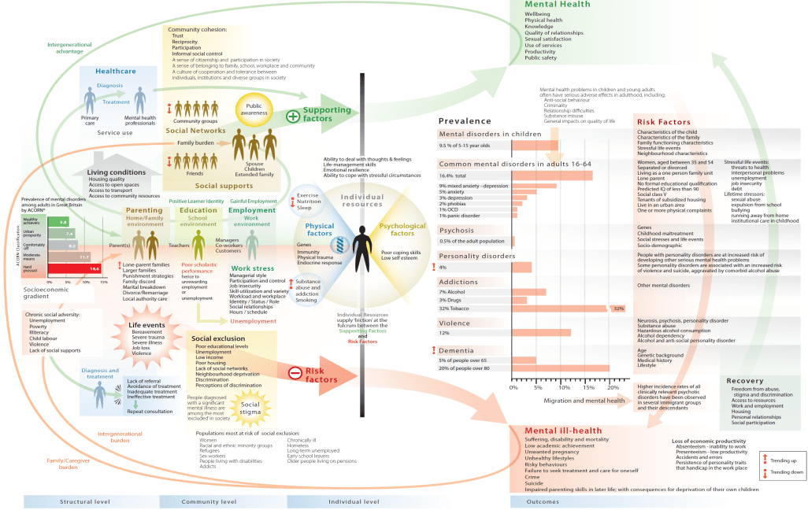
Source: Foresight 2008
Notes:
Complexity
Risk and Protection
Life-course approach
Social determinants approach

Slide 4
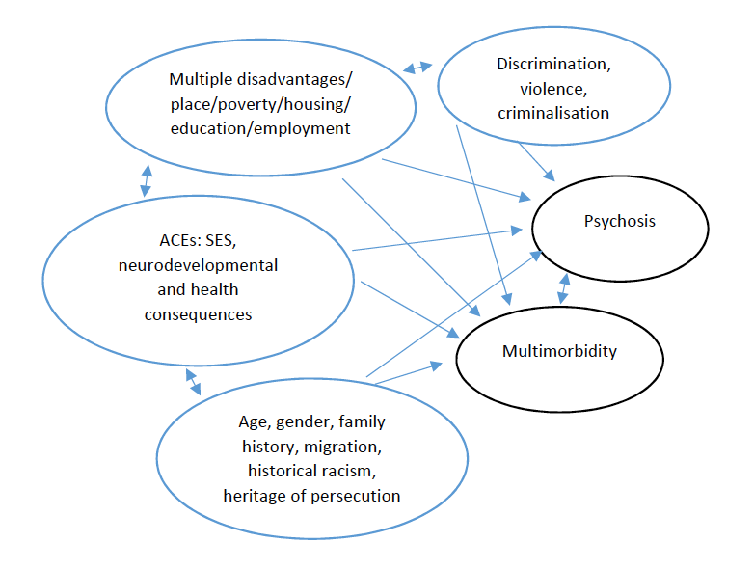
Context & Environment
Urbanisation
Air Quality
Migration and ancestral history
Housing
Social/cultural
Community Assets/Adversities
Services
Geo-politics
Intervention
Embodied
Culturally adapted
‘Condition’ specific Training and commissioning
Research and Services
Complex Structural competence
Coercion
MHA
Criminalisation Exclusion
Destructive
Epistemic injustice
Assessment
Identity, EM
Trust
Health literacy
Historical, Life course, Complex
Attachment, Dynamic
Co-morbidities Social position, poverty
Gender, race, intersections
Research and Political Framing of Mental Illness and inequalities
Eco-social, cultural, syndemic frameworks
Health Inequalities

Slide 5
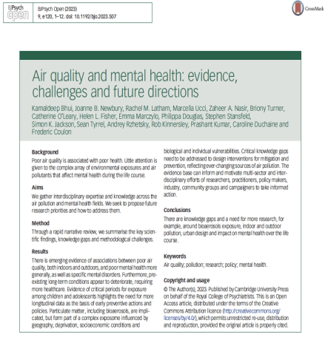
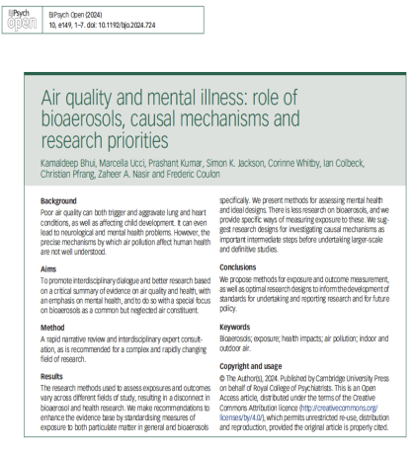

Slide 6
Exposome and poor mental health
Exposome: air quality, geographical and built environment, social variables such as housing, adversity, stigma, discrimination, crime, violence, poverty, access to education and employment, access to green-blue-brown space, noise, building design and sick buildings.
Personal demographic, biological, and social variables
immune function and epigenetic and genetic risks of mental illness
Proximal exposome: housing, damp, fungi/mold, cockroaches, control over immediate environment
Poor physical health = poor mental health
Risk factors for onset
Interactions over time including quality of life and mortality
Self-care, exercise/activity, health risk behaviours

Slide 7
Environment, Poverty, Inequality
Depression includes pessimism, poor self-care, a lack of motivation, compounds adverse effects of poverty by reducing social support and risking unemployment.
Poverty/food scarcity impact on cognitive decisions,³⁶ making brain vulnerable to poor air quality.
Poor housing/fungal exposure: direct and indirect effects (through respiratory issues).¹⁹ ³⁷
SMI: poor outcomes if impaired lung function and/or respiratory disease, and high levels of air pollution.³⁸ ³⁹ ⁴⁰
Adversity and poverty can produce inflammation in mothers, the foetus in utero, young children and young adults, as well throughout the life course.⁴³
Amongst deprived inner-city areas, health risk behaviours are more common

Slide 8
Bio-social pathways
Psychological and social adversity, lack of social support, drivers of health inequalities and histories of adversity (e.g. ACEs and poor adult MH)
Poor physical health associated with poor mental health and vice versa
Neurodevelopment (ND) impacted at critical periods (in utero, early childhood, adolescence)
Drivers of ND problems may also lead to neurodegenerative conditions. Children exposed to air pollution already showing hallmarks of degenerative conditions of old age.
Autism and ND disorders in those exposed to AP in pregnancy

Slide 9
Sources
Release mechanisms
Higher risk of Exposure
Health risk
Soil
Dust and/or volatiles emissions
Poor housing, poverty, deprivation
Immune and endocrine responses
Water
Aerosolization
Crowding
Development of allergy
Plants
Resuspension
Lack of green space
Mental health issues
Animals
Reductions in public services
Ventilation systems
Medical health issues
Humans
Contaminated water
Absence of carers, protection, safe space.
Life course health impacts: critical periods
Indoor environments¹
Psychosocial vulnerabilities
Demographics
Agricultural activities
Mitigations
Policy interventions
(cross-sector)
Health Service interventions
Individual interventions
¹(e.g. schools, workplaces, hospitals, shopping malls)

Slide 10
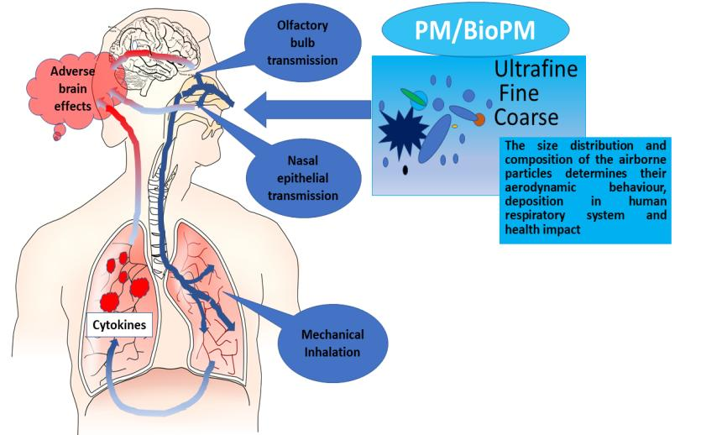

Slide 11
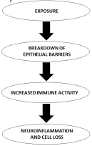
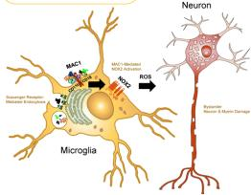
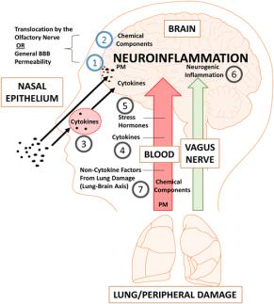
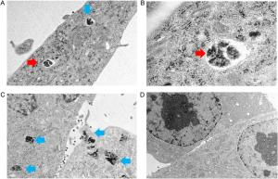
How air pollution alters brain development: the role of neuroinflammation
D’Angiulli A. Front. Public Health 2018; 6: 95.

Slide 12
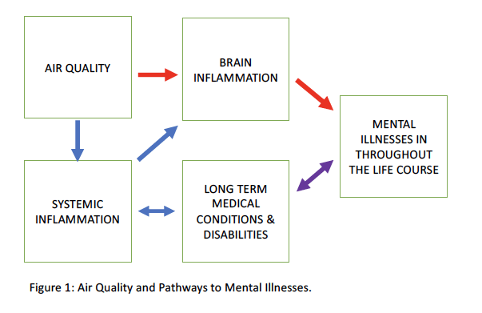

Slide 13
RCP report in summary (next 7 slides)
Depression and PM_{2.5}
Less on psychosis, but evidence of incidence and relapse
Neurodevelopmental disorders
Physical health associated with mental illness, both affected
E.g. asthma, antipsychotic prescribing, more deaths.
Critical periods
Pregnancy/fetus
Childhood and adolescence
Working populations
Older people

Slide 14
Systematic Reviews and Highlights
Convincing evidence of associations between depression and PM_{2.5}.²
5 cohort studies (mostly cross-sectional) and time series studies from high- and low- income countries.
Significant heterogeneity and potential selection biases.
Much less on psychoses, and specific conditions such as schizophrenia or personality disorders.
Observational evidence implicates outdoor air pollutants as risk factors for a variety of mental health problems, including depression, anxiety, personality disorder, and schizophrenia.³⁻⁵

Slide 15
The RCPCH & RCP
Construction material emissions, building design (e.g., ventilation and heating systems), activities inside buildings (e.g. cooking, fireplaces, cleaning products, moisture production) all -> poor indoor air quality and affect health.¹⁹
Poor indoor air quality -> neurological/psychological symptoms; with cognitive /behavioural effects.
e.g. higher CO₂ levels (+ pollutants associated with CO₂₎ impact negatively on cognitive function and concentration.
Ongoing debate on the effects of CO₂ concentrations on cognitive performance in settings such as schools and offices.²⁰

Slide 16
Critical Periods
In childhood and adolescence
Pre-existing health problem
Short term and over the life course.
AP -> ischaemic stroke and neurodegeneration; evidence of direct transmission through olfactory bulbs to the brain, systemic circulation and inflammation.⁶
Children exposed to fine and ultra-fine PMs, already show evidence of the hallmarks of Alzheimer’s and Parkinson's diseases, namely hyperphosphorilated tau, amyloid plaques and misfolded α-synuclein.⁷
Traffic related air pollution has detrimental effects on working memory of children in schools in Barcelona, strongest effects for outdoor NO₂ and indoor ultra-fine particles, over a 3.5 year period.⁸

Slide 17
Pregnancy, Early Years
Mixed findings
Pre-natal air pollution exposure has been linked with cognitive impairments at age five²³.
During pregnancy, exposures to PM₁₀, PM_{2.5}, NO₂, and nitrogen oxides (NO_{x)} were associated with a 29%–74% increased odds of unspecified mental disorders that complicated pregnancy.²⁵
Exposure pathways in utero and early childhood differ from those in adulthood; for example, in utero, neo-natal and infancy pathways may include ingestion (non-nutritional as well as nutritional), inhalation, transplacental, transdermal, and breast feeding.²⁶

Slide 18
Adolescence
Psychotic experiences (among 2063 adolescents) more common in the highest (top quartile) level of annual exposure to NO₂, and PM_{2.5}.²⁷
No evidence of confounding by family socio-economic status, family psychiatric history, maternal psychosis, childhood psychotic symptoms, adolescent smoking and substance dependence.²⁸
Comparative studies comparing Mexico City to less polluted areas.
One post-mortem study³⁰ compared prefrontal white matter between children and teenagers in Mexico City versus a less urbanised area: ultrafine PM was found in the former but not the latter group’s brain cells.

Slide 19
Adults
Study of 87 potential air pollutants in the USA and 14 in Denmark.
PM₁₀ and PM_{2.5}, diesel emissions and NO₂, and organic substances (polycyclic aromatic hydrocarbons) associated an increased risk of psychiatric disorders.³¹
Associations with bipolar disorders in both countries; and depression, schizophrenia, personality disorder in Denmark.
SR and MA: associations of PM_{2.5} + PM₁₀ with depression, anxiety, bipolar disorder, psychosis, suicide in adults.
The most apparent association was between long-term (>6 months) exposure to PM_{2.5} and depression.³²
Depression and suicide were the most studied outcomes; no studies of long-term PM exposure and suicide, bipolar disorder.
Air pollution -> service use for mental disorders; more admissions and emergency care.¹⁵ ³³ ³⁴
These suggest exacerbation of existing conditions requiring greater levels of health care.

Slide 20
Neurodevelopmental Disorders
Xenobiotic heavy metals (such as lead and cadmium), PM, and nitrogen and sulphur oxides, organic solvents, and other constituents of environmental pollution could be component causes of neurodevelopmental disorders such as schizophrenia.²¹
Systematic review: depression, suicide, and neurodevelopmental disorders (such as autism for pregnancy related exposures) may be more common among those exposed to air pollution.²²

Slide 21
Conclusion
There are associations between poor air quality, both indoors and outdoors, and poor mental health/specific mental disorders.
Incidence, admissions, pre-existing conditions deteriorate
Critical periods: children and adolescents, need longitudinal data, early preventive actions
ND, Dementia, Mental Illnesses
Particulate matter in a complex exposome: geography, deprivation, socio-economic conditions, and biological and individual vulnerabilities.

Slide 22
Implications
Critical knowledge gaps: exposure measurement, longitudinal cohorts, mental health measures, indoor and outdoor pollution, urban design, and mental health impacts over the life course.
The evidence base to motivate multi-sector and interdisciplinary efforts of researchers, practitioners, policy-makers, industry, community groups, and campaigners to take informed action.

Slide 23
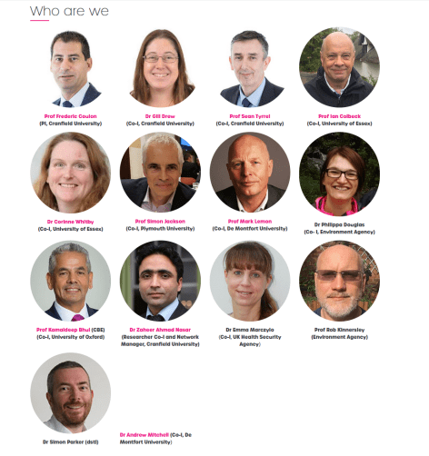
Thanks
Stephen Holgate
Garry Fuller
Suzanne Bartington
Brian Castellani
Prashant Kumar
Marcella Ucci
Joanne Newbury
Briony Turner
Caroline Duchaine
Andre Rzhetsky
Helen Fisher
Stephen Stansfeld
Kathryn O’Leary
Christian Pfrang
Website: https://bioairnet.co.uk/
Twitter: @BioAirNet1
Get in touch: contact@bioairnet.co.uk

Slide 24
Thanks
@ksbhui
Kam.bhui@psych.ox.ac.uk

